Slide 1
Smart Garden
MIT Scratch: A Story, A Game

Slide 2
MIT Scratch
MIT Scratch is a platform you can program your own interactive stories, games, and animations for Web and Mobiles

Slide 3
Concept
Create a scratch story based on a garden
Information of Garden flowing in animations
Specific plant
Audio should be loaded
Classification should be performed based on genres
Character reaction

Slide 4
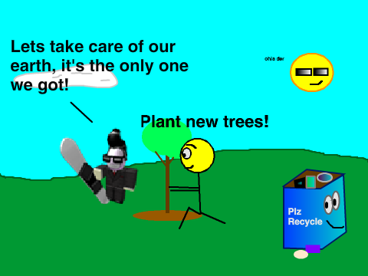

Slide 5
Tools & Technology
Android
MIT Scratch
Scratch Studio
Scratch Programming

Slide 6
References
https://resources.scratch.mit.edu/www/guides/en/Getting-Started-Guide-Scratch2.pdf
https://scratch.mit.edu/tips
https://scratch.mit.edu/discuss/topic/236734/

Slide 7
Smart Gardening
Using Augmented Reality

Slide 8
Concept
Plant Life Cycle in Augmented Reality
Plants growth
Plants agricultural process
Mobile Application
Augmented Reality
Story creation according to the plant

Slide 9
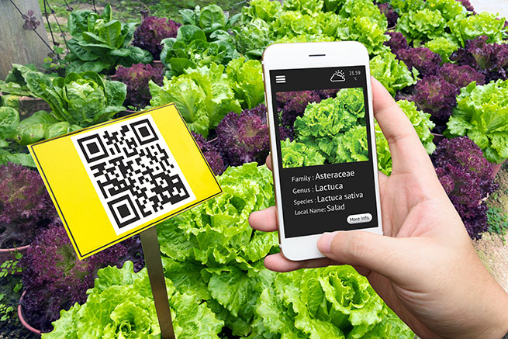

Slide 10
References
https://www.sciencedirect.com/science/article/pii/S1474667016335613
https://www.fastcompany.com/40468146/machine-learning-helps-small-farmers-identify-plant-pests-and-diseases

Slide 11
Smart Gardening
A Machine Learning Approach

Slide 12
Use Case
Mobile application, take a small video clip
Plant type recognition
Current weather detection
Location of the garden
Notification system for informing the admin

Slide 13
Continued ..
Water suggestion is made in the admin by raising notifications
On screen stop watch for the amount of water required by garden
10 day weather forecast
Recommendations
Water required breakup on daily basis

Slide 14


Slide 15
References
https://github.com/aosp-mirror/platform_development/tree/master/samples/ApiDemos
https://github.com/hpi-xnor/android-image-classification

